Slide 1
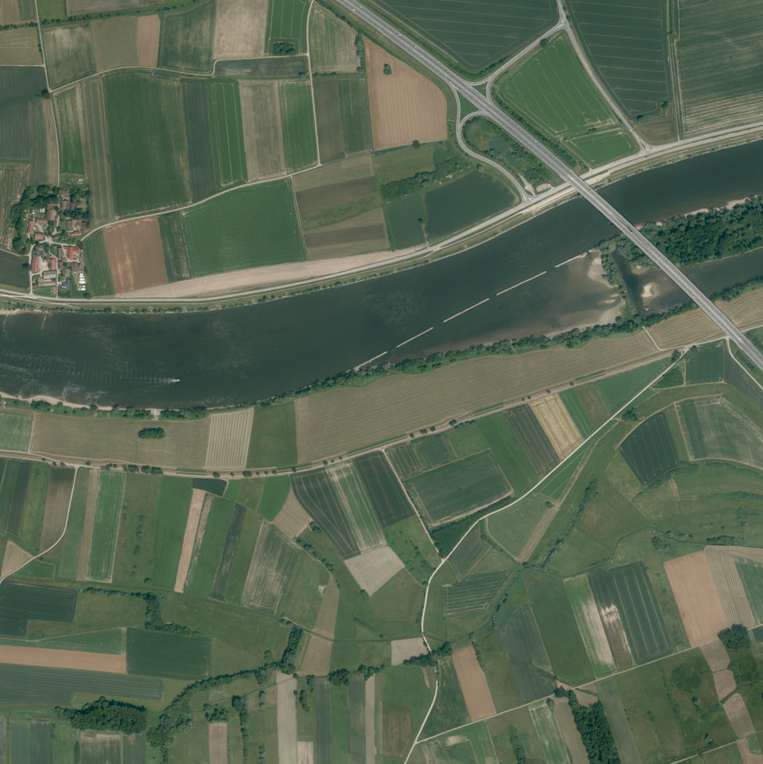
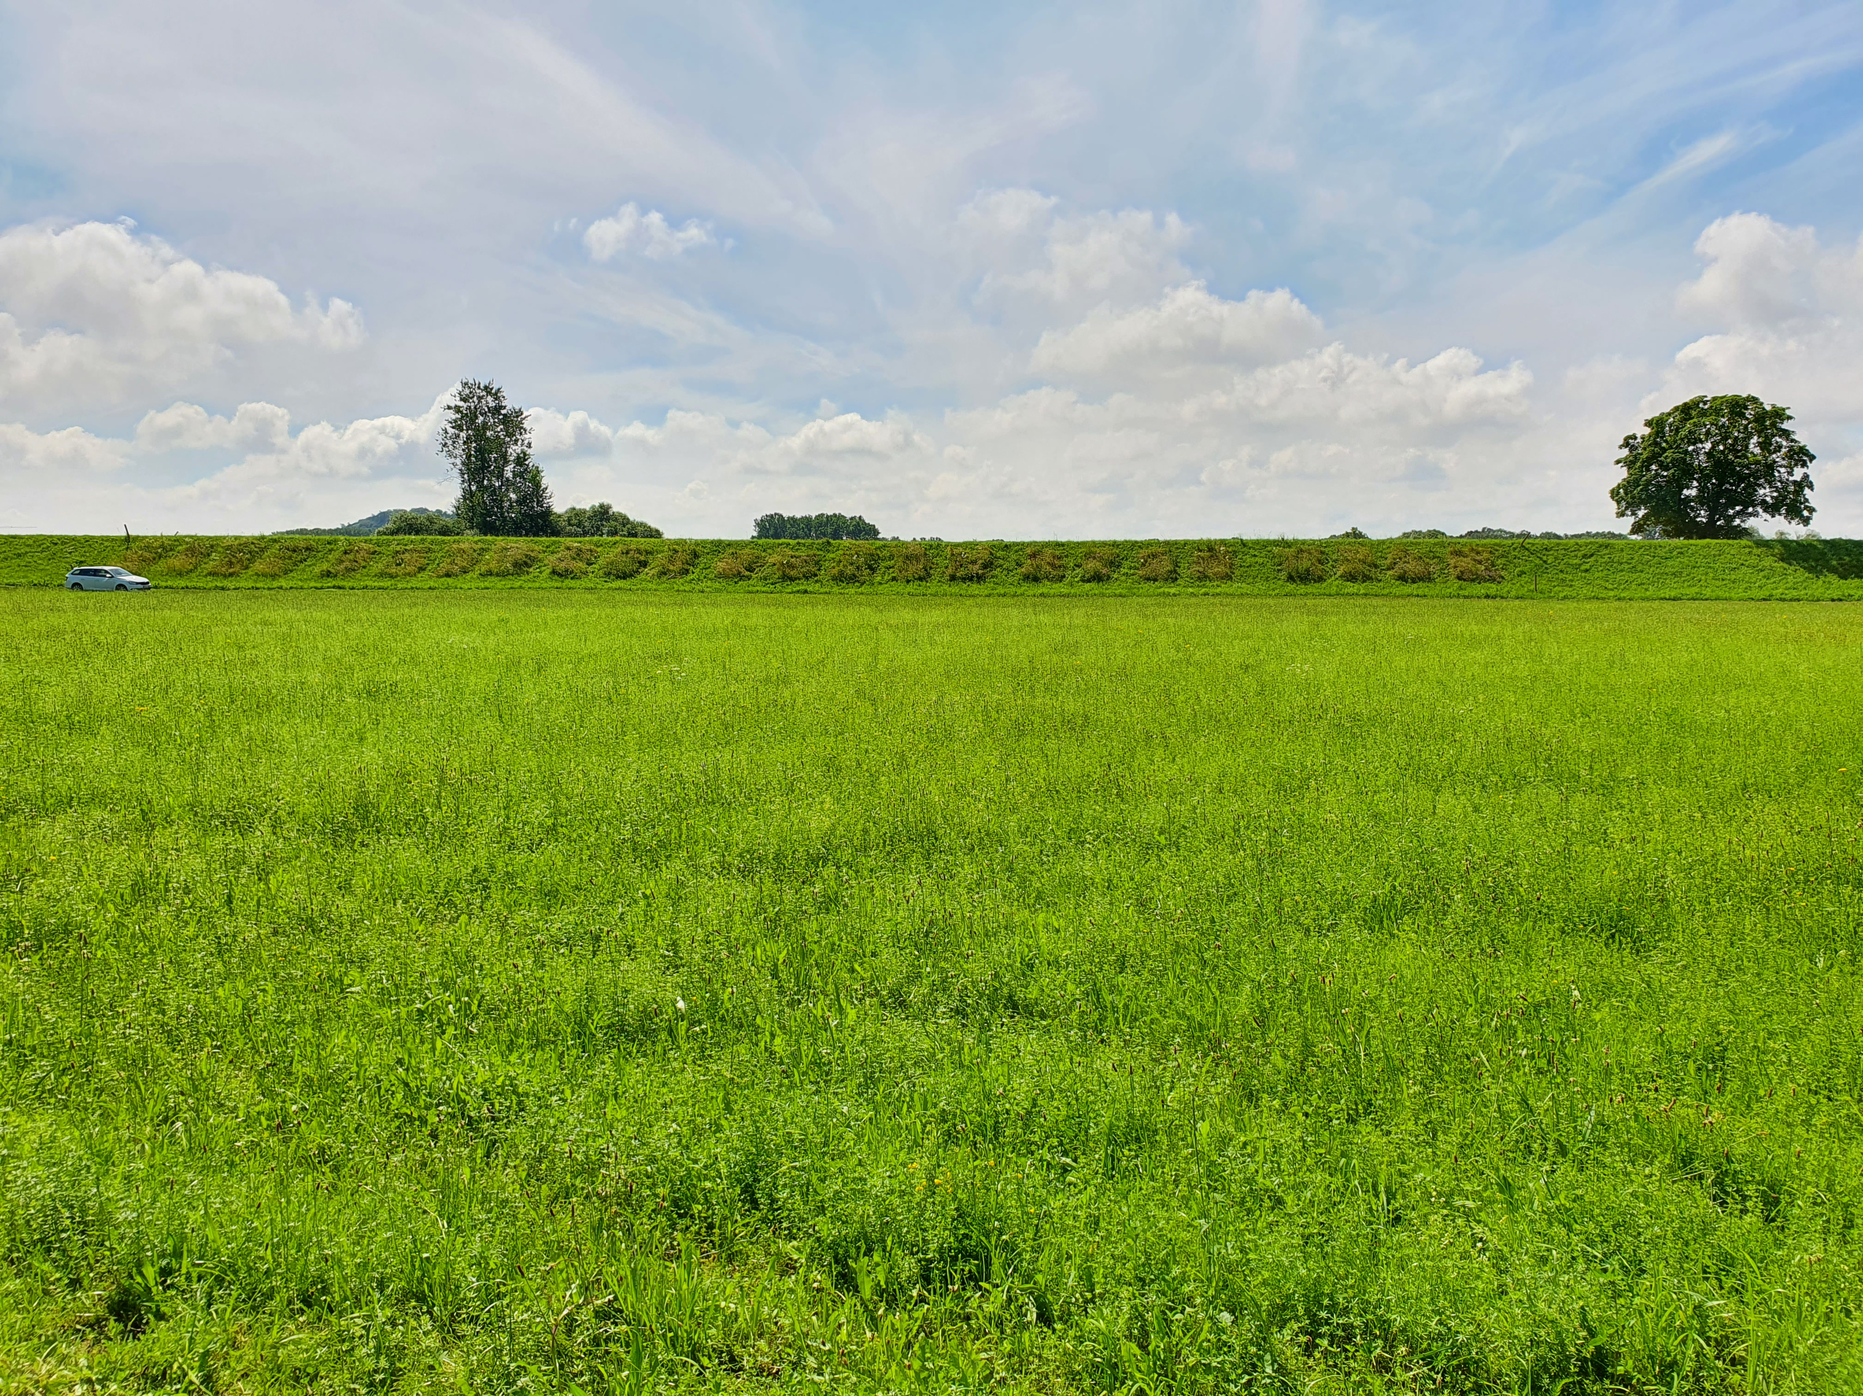
6
5
3
4
1
2
BayernAtlas
100 m
Sand admixture:
0%
25%
50%
block 5
dike top
Substrate depth:
15 cm
30 cm
street
Seed density:
4 g m⁻²
8 g m⁻²
BayernAtlas
north
water side
48 plots per block:
D
H
D
H
D
H
D
H
D
H
D
H
H
D
D
H
H
D
H
D
D
H
D
H
dike top
D
H
D
H
H
D
D
H
H
D
D
H
H
D
D
H
H
D
H
D
D
H
D
H
south
street

Slide 2
 | Einzeldownload 32784_5417.tif
Einzeldownload 32785_5417.tif
Einzeldownload 32784_5416.tif
 | Einzeldownload 32785_5416.tif

